Slide 1

Low-Cost Optical Communications System
By: Team 3 (Jarrod Siglin, Cameron Martinez, Sean Huber, Matthew Simms, Dylan Koch, Dominic Steiner)

Slide 2
Why Optical Communications?
Near infra-red frequencies (750-1600 nm)
Demand for RF spectrum is outstripping supply
New frequency bands needed
Benefits:
High data transmission rate (over 100 Gbps)
Less power consumption than radio, microwave and other similar technologies
Small/light physical design
Considered emerging technology by NASA and other aerospace companies
More research will lead to decrease in cost and application difficulty
Notes:
Optical Communications is a relatively new technology that allows for rapid, high-bandwidth wireless transmission of data across nearly any distance.
This technology can transfer data at rates much faster than radio, microwave, or other contemporary technologies (over 100Gbps), all the while using less power, a smaller payload size, and an overall smaller/lighter physical design.
Researching and developing Optical Communication Systems will benefit multiple industries, especially the Aerospace Industry, as transmissions across the solar system would require less power and time to receive the same amount of information compared to a different transmission style.
Proliferation of this technology would lead to a decrease in cost and difficulty in application; can have positive impacts for other industries that already require fast, wireless transfer of data.

Slide 3
Design Considerations
Cost
System shall cost under $2000 USD.
System shall use commercial-off-the-shelf (COTS) components.
Hardware
System shall use a 1550 nm wavelength laser diode (NIR-C class).
System shall be remotely operated via a SSH server/client connection.
System shall operate across free space.
Software
System shall use the OpenCV libraries, for encoding and decoding the video feed.
System shall use Python3 for all software implementation.
System shall use On-Off Keying (OOK) for modulation.
Notes:
Design Considerations o Assumptions, dependencies o General Constraints o Industrial Standards Followed (if there are any) o Safety constraints and considerations o Other

Slide 4
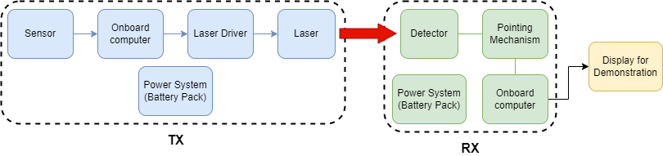
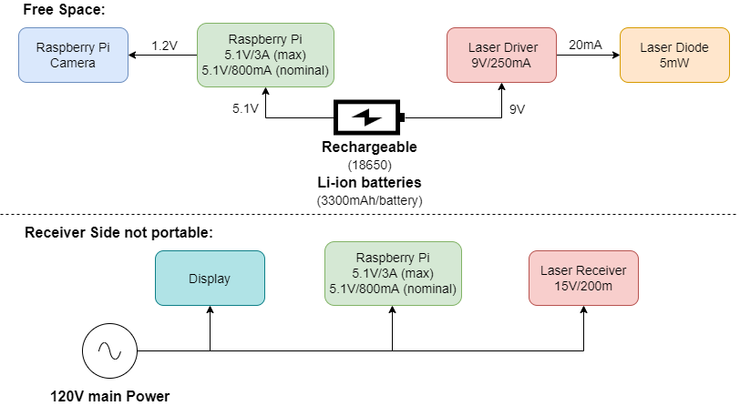
System Architecture and Design
Free space communication
1552nm laser diode
Performed using O.O.K to communicate the UART standard.
Two subsystems: TX and RX
TX – Modulate laser via diode driver using video data.
RX – Demodulate received data into video display and save it remotely.
Software will be handled on the host RPI for both TX and RX, using python3 and RPI specific GPIO APIs.

Slide 5
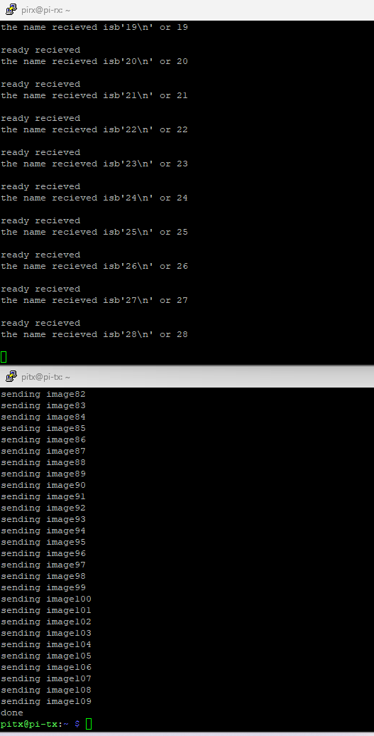
Software
Goals:
Improve performance of Rx pi
Convert the image string to a mjpeg stream
Display the mjpeg stream on a flask local webpage
Test throughput with added inversion and voltage scaling circuit.
Send and receive images

Slide 6
Project Timeline
Previous Sprint 3:
Learn to operate new sensor
Modulation with Raspberry Pi's
Used new lenses to increase transmission range
Planned Sprint 4
Complete modulation with Raspberry Pi's
Integrate camera to transmitter and a visual display to receiver.
Design and create power sub-systems for system.

Slide 7
Project Timeline
Actual Sprint 4:
Reconstructed circuit and determined faulty components
Designed and simulated power sub-system
Tested UART serial connection via wire
Planned Future Sprints:
Complete modulation with Raspberry Pi's
Integrate camera to transmitter and a visual display to receiver.
Purchase and construct power sub-system

Slide 8
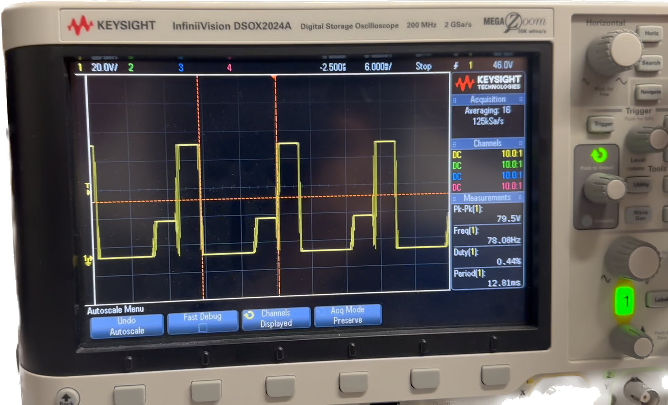
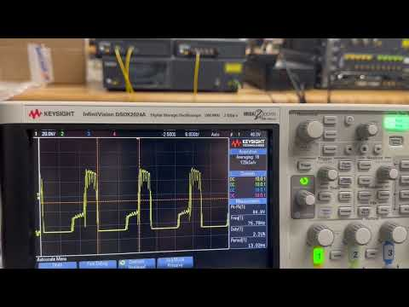
Sprint 3: Test transmission of modulated signal.
Test Transmission Signal Demo

Slide 9
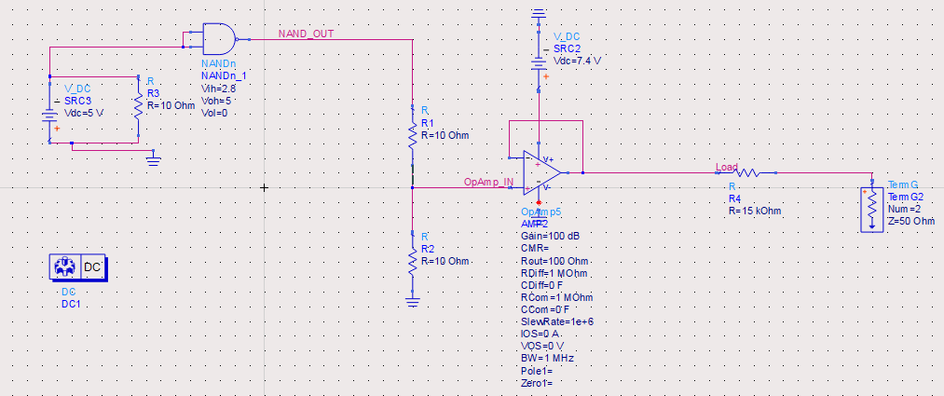
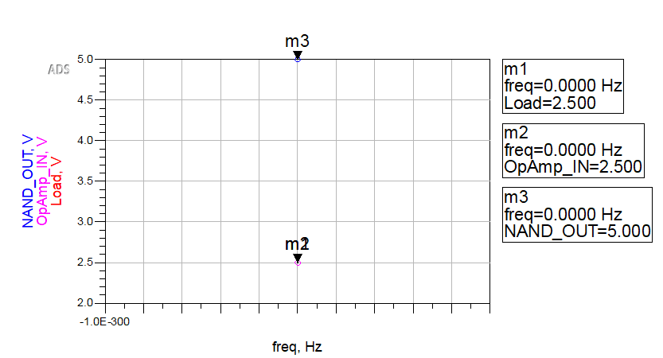
Sprint 4: RasPi voltage scaler circuit design and simulation.

Slide 10
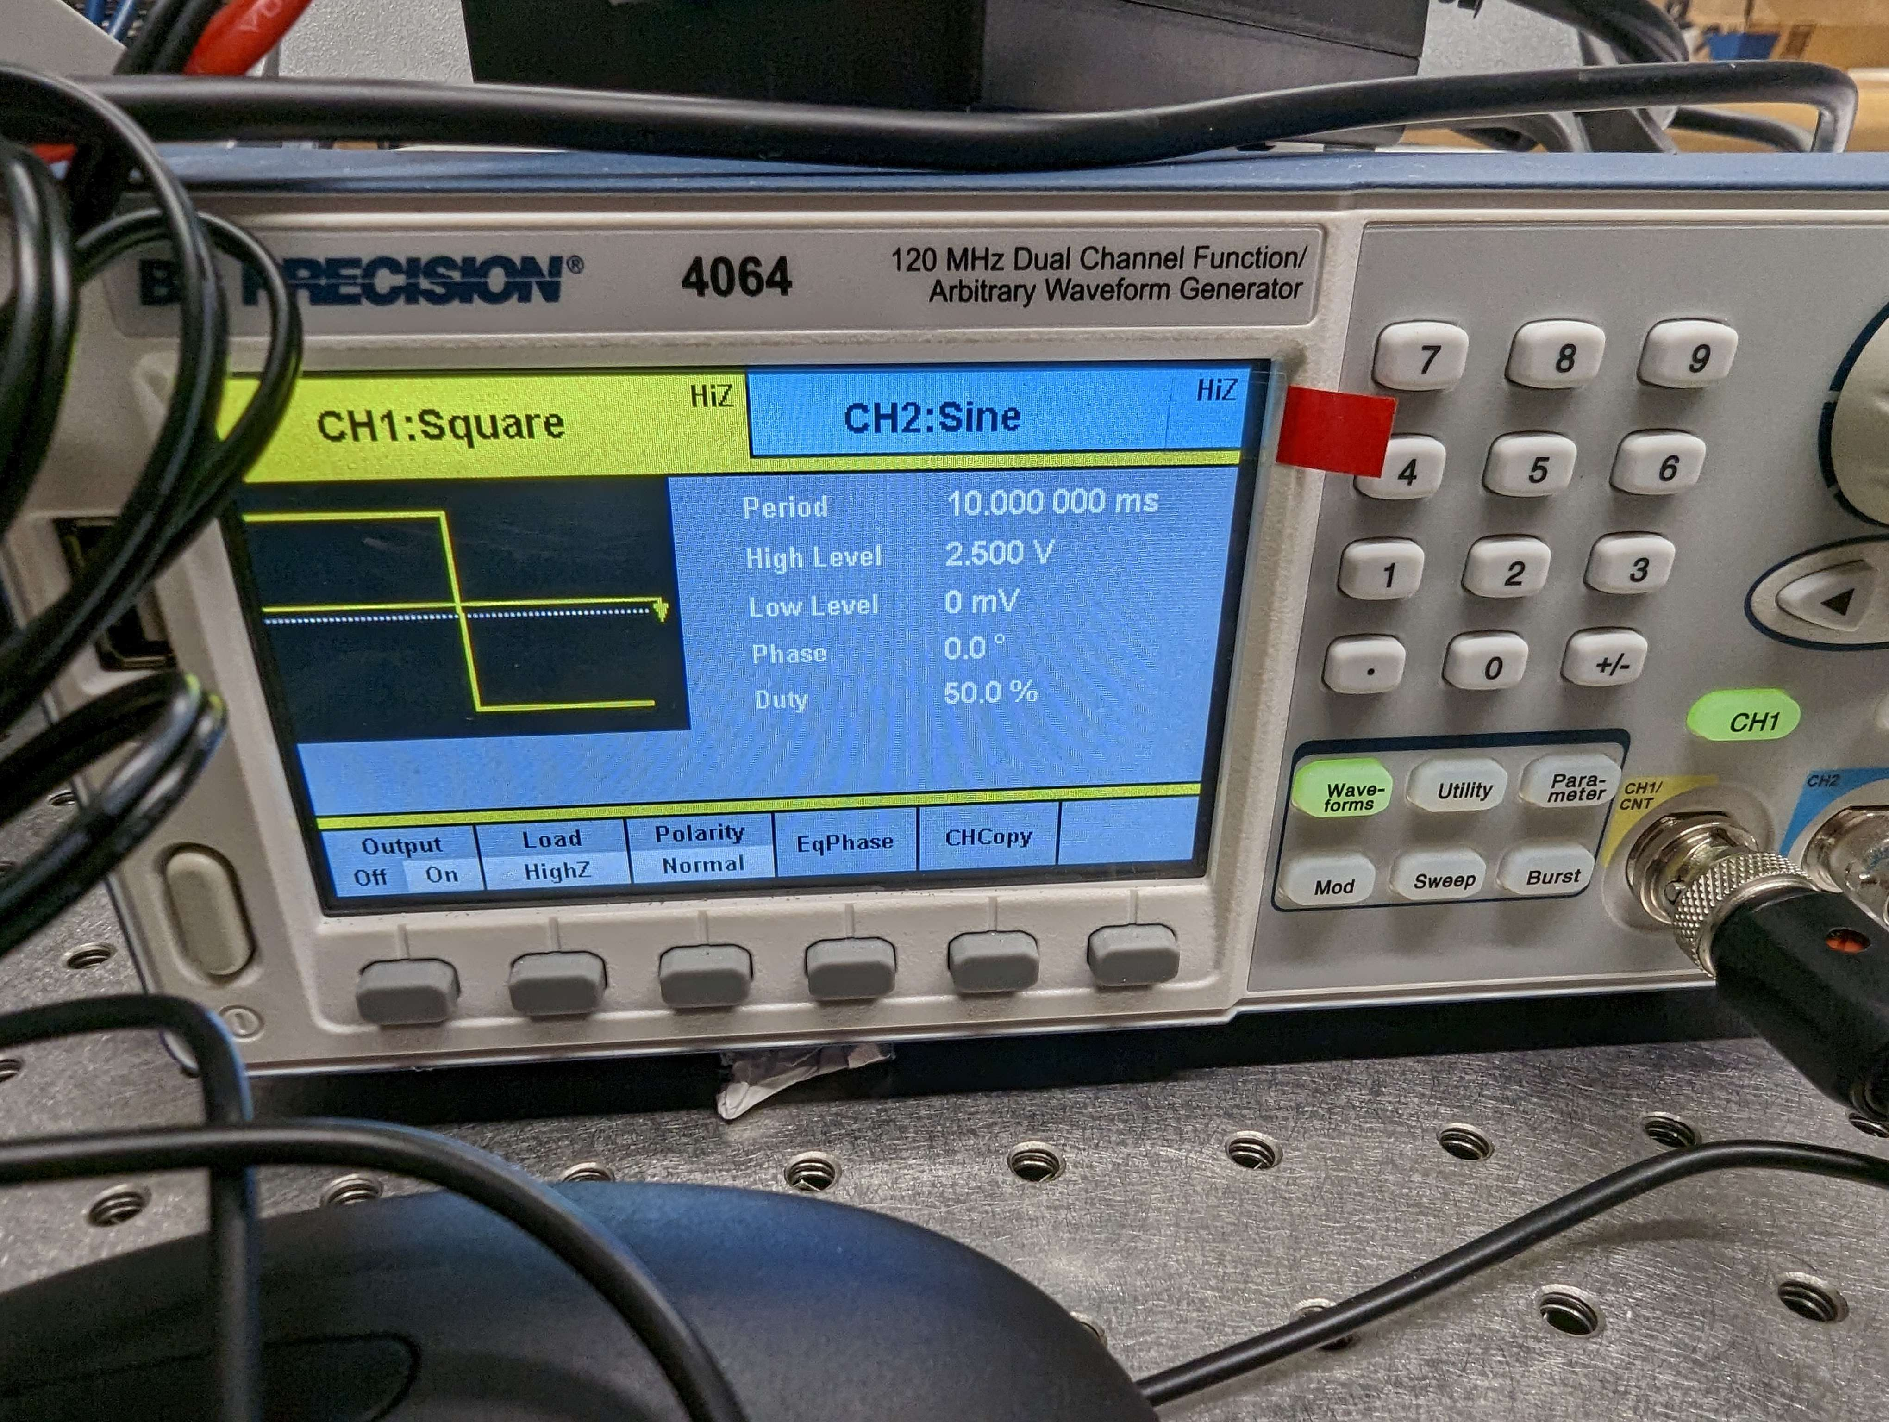
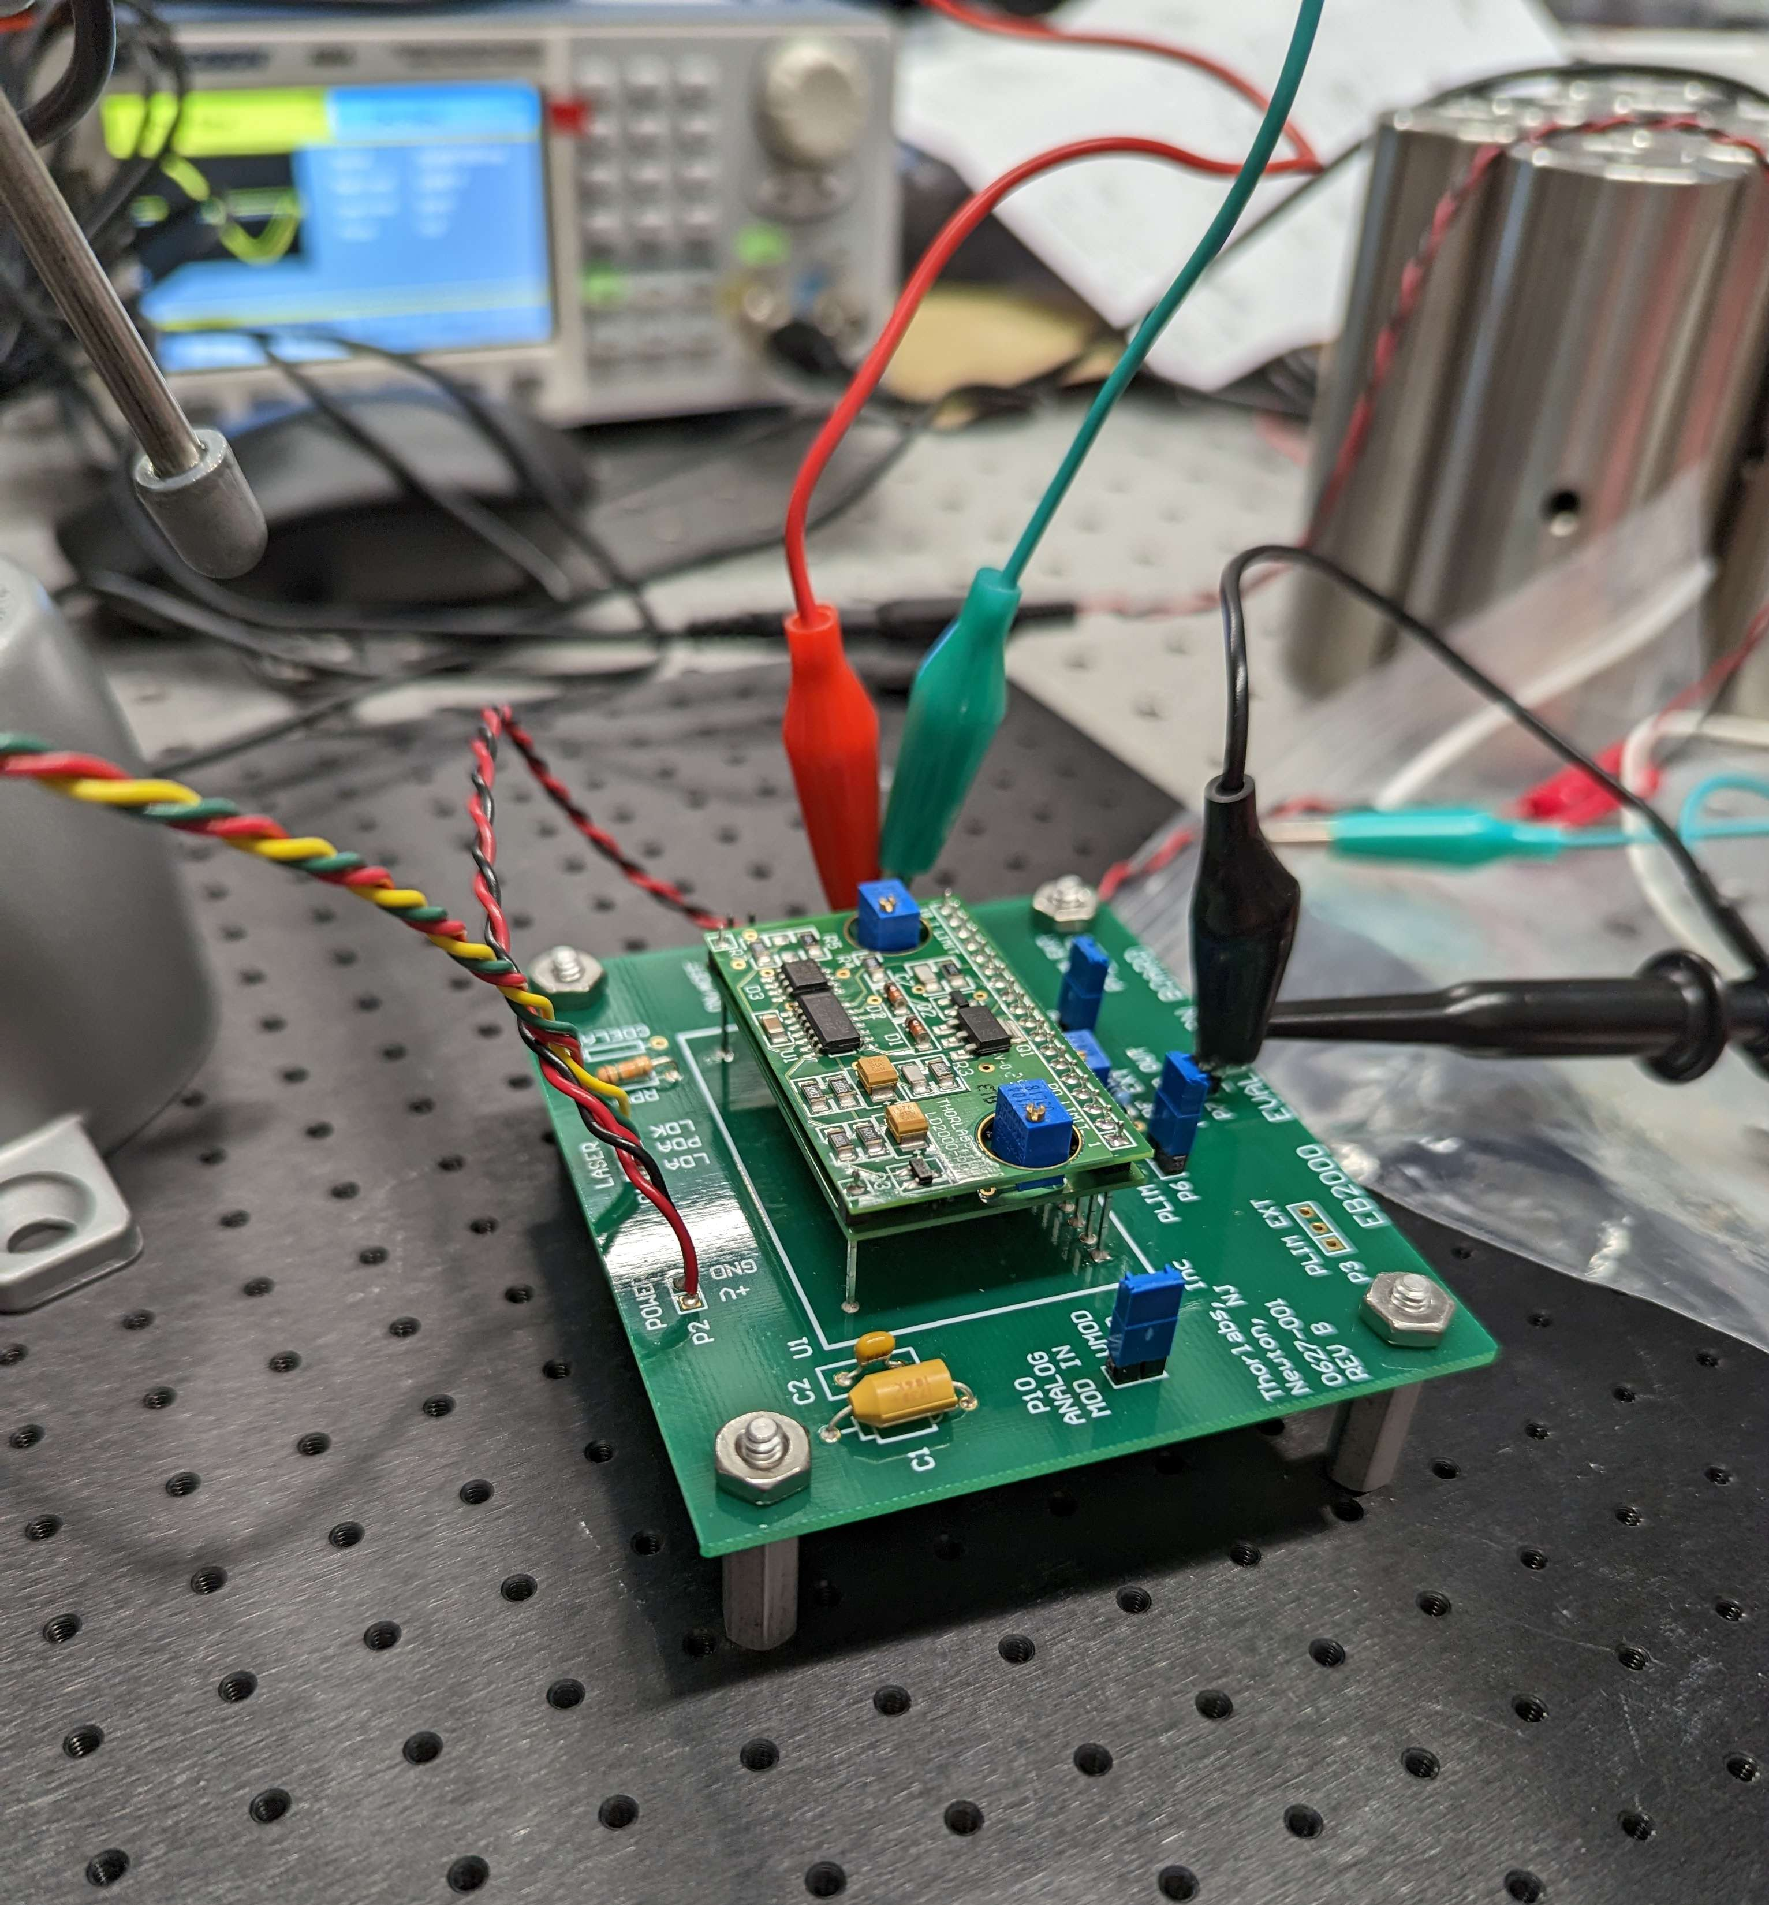
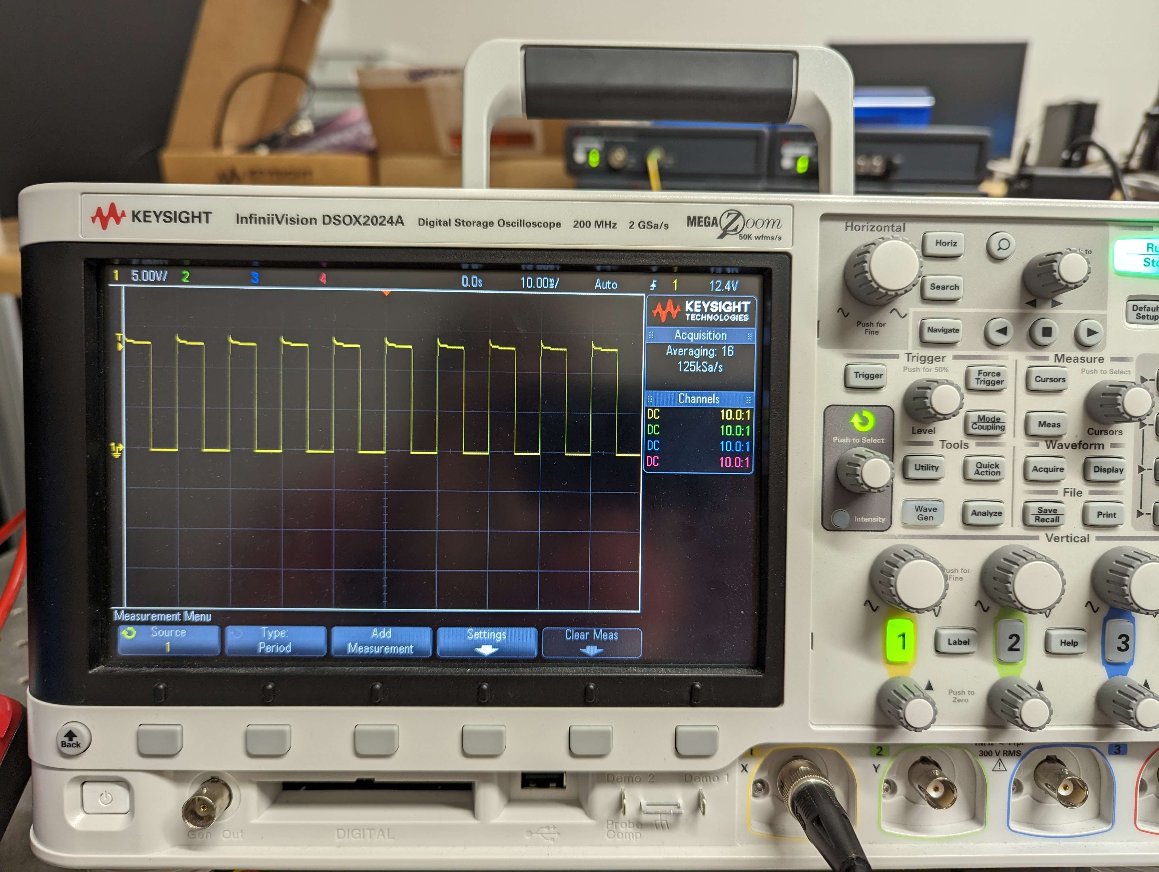
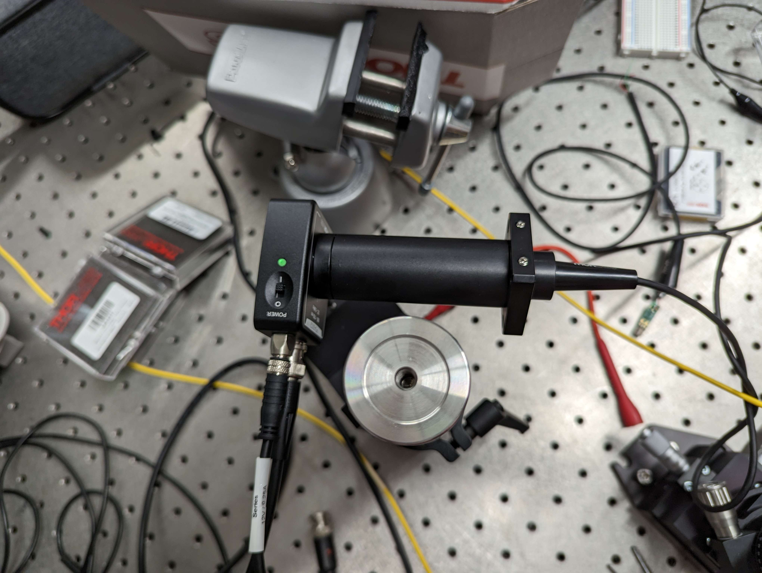
Sprint 4: Testing of new equipment

Slide 11
Questions?
Ask away!

